Slide 1
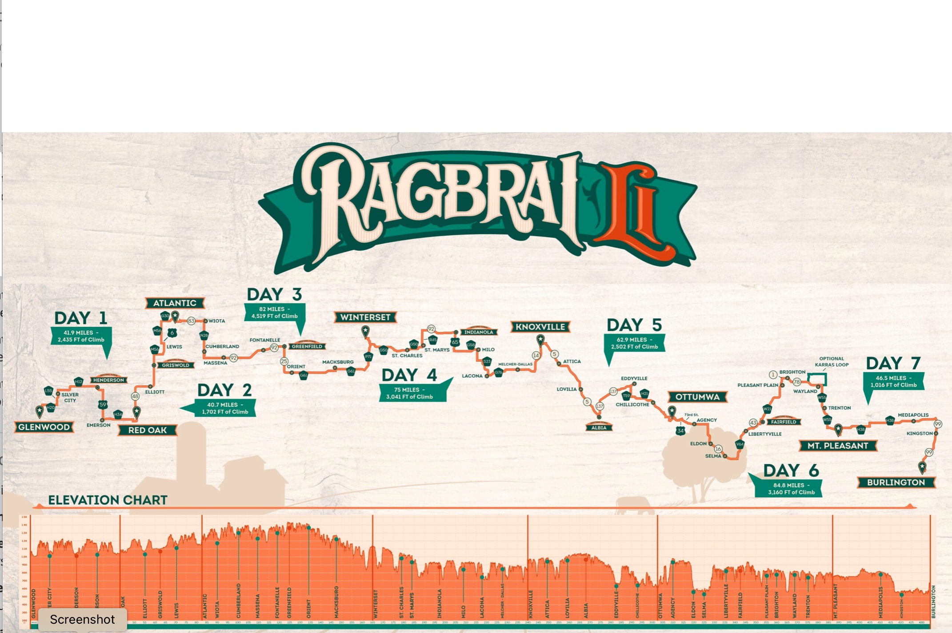
Bob Recker Deb Bartels 19 June 2024
Cedar Valley Cyclists
2024 RAGBRAI LI CHARTER
CVC Campsite Location and Information

Slide 2
Campsite Imagery and Locations
Version: 19 June 2024

Slide 3
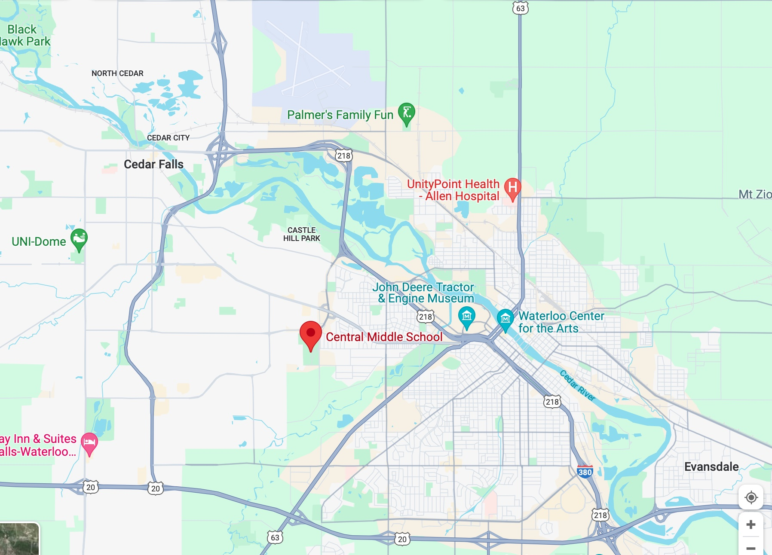
Departure Day: Saturday, 20 July 2024
Waterloo, IA
Central Middle School
Street Address: 1350 Katoski Drive
GPS Coordinates:
Lat 42.494844
Lon -92.396801
Loading Starts 7:00 am
All Checked in 8:00 am

Slide 4
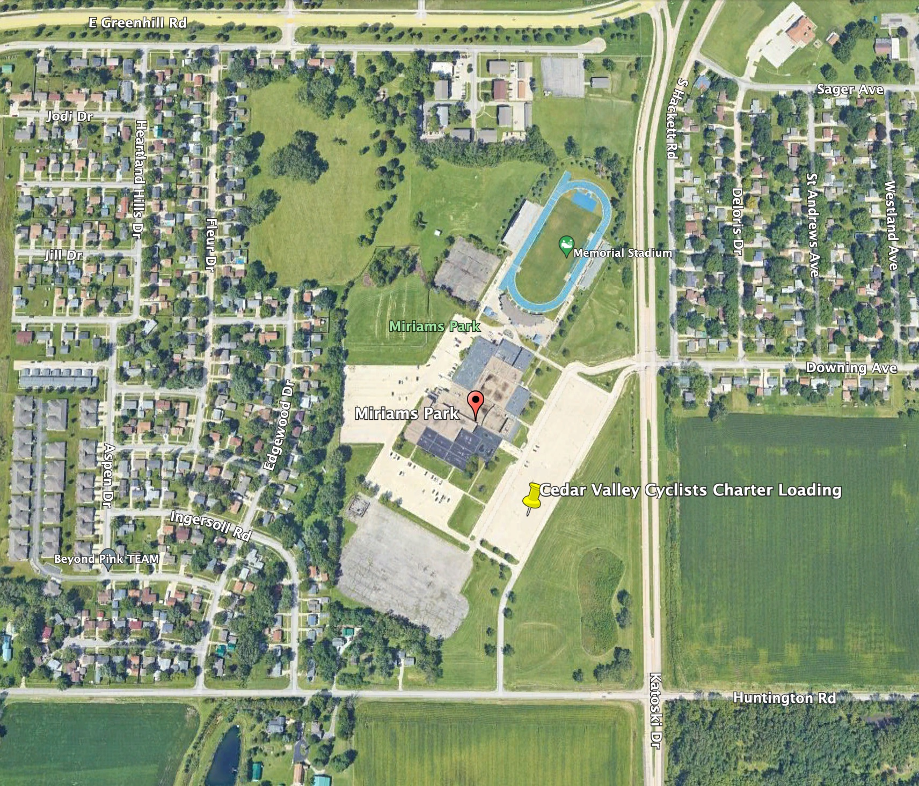
Departure Day: Saturday, 20 July 2024
Waterloo, IA
Central Middle School
Street Address: 1350 Katoski Drive
GPS Coordinates:
Lat 42.494844
Lon -92.396801
Loading Starts 7:00 am
All Checked in 8:00 am

Slide 5
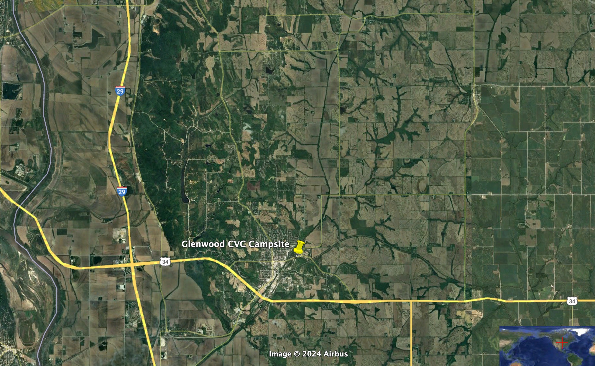
Glenwood: Saturday, 20 July 2024
Approx. Street Address:
101 Sharp St.
GPS Coordinates
Lat 41.047973
Lon -95.732695

Slide 6
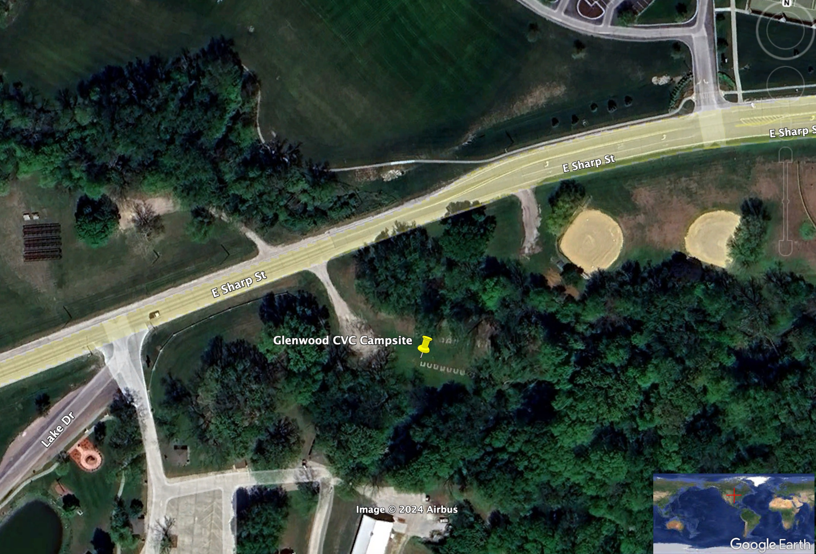
Glenwood: Saturday, 20 July 2024
Approx. Street Address:
101 Sharp St.
GPS Coordinates
Lat 41.047973
Lon -95.732695

Slide 7
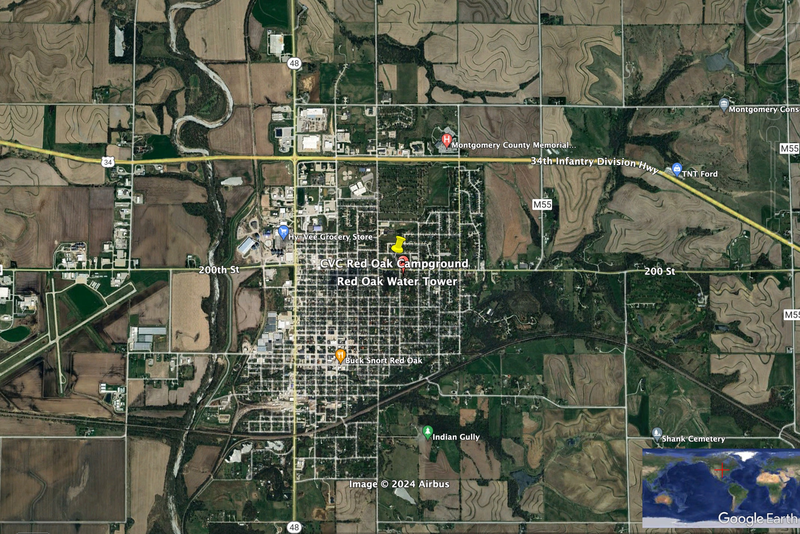
Red Oak: Sunday, 21 July 2024
Approximate Street Address
Water Tower, Red Oak, IA
GPS Coordinates
Lat 41.017225
Lon -95.221380

Slide 8
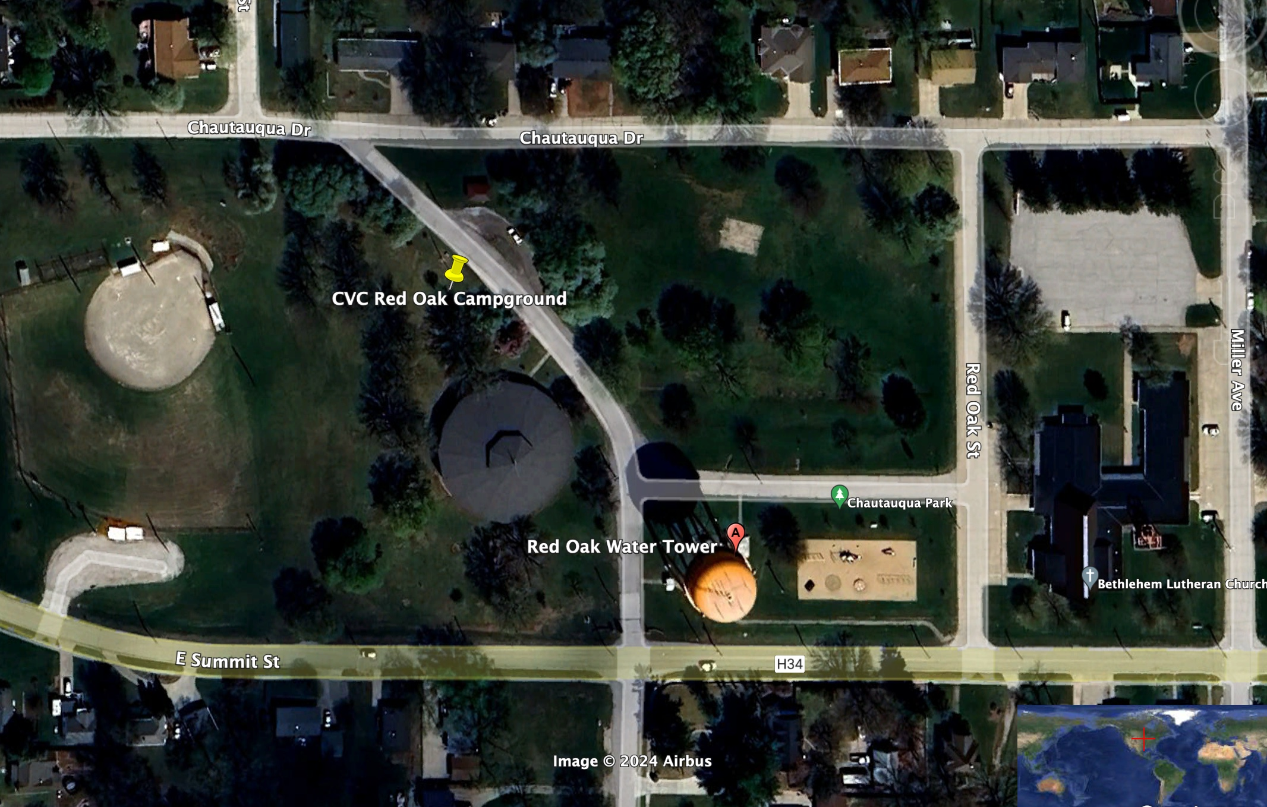
Red Oak: Sunday, 21 July 2024
Approximate Street Address
Water Tower, Red Oak, IA
GPS Coordinates
Lat 41.017225
Lon -95.221380

Slide 9
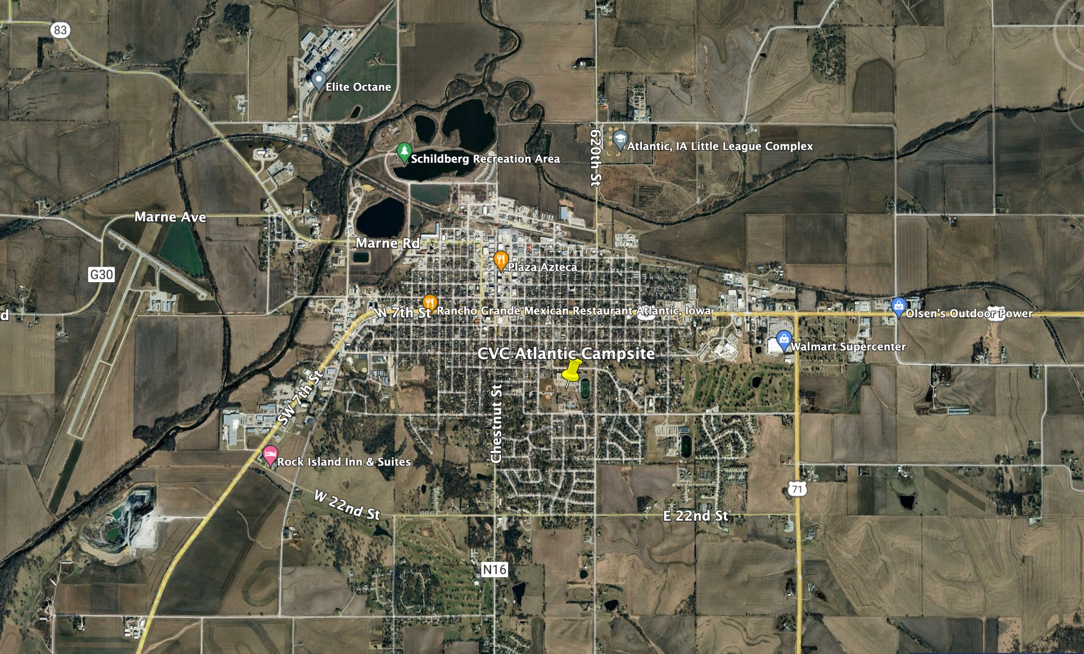
Atlantic: Monday, 22 July 2024
Approximate Street Address:
1100 Linn St, Atlantic, IA
GPS Coordinates
Lat 41.398435
Lon -95.006273

Slide 10
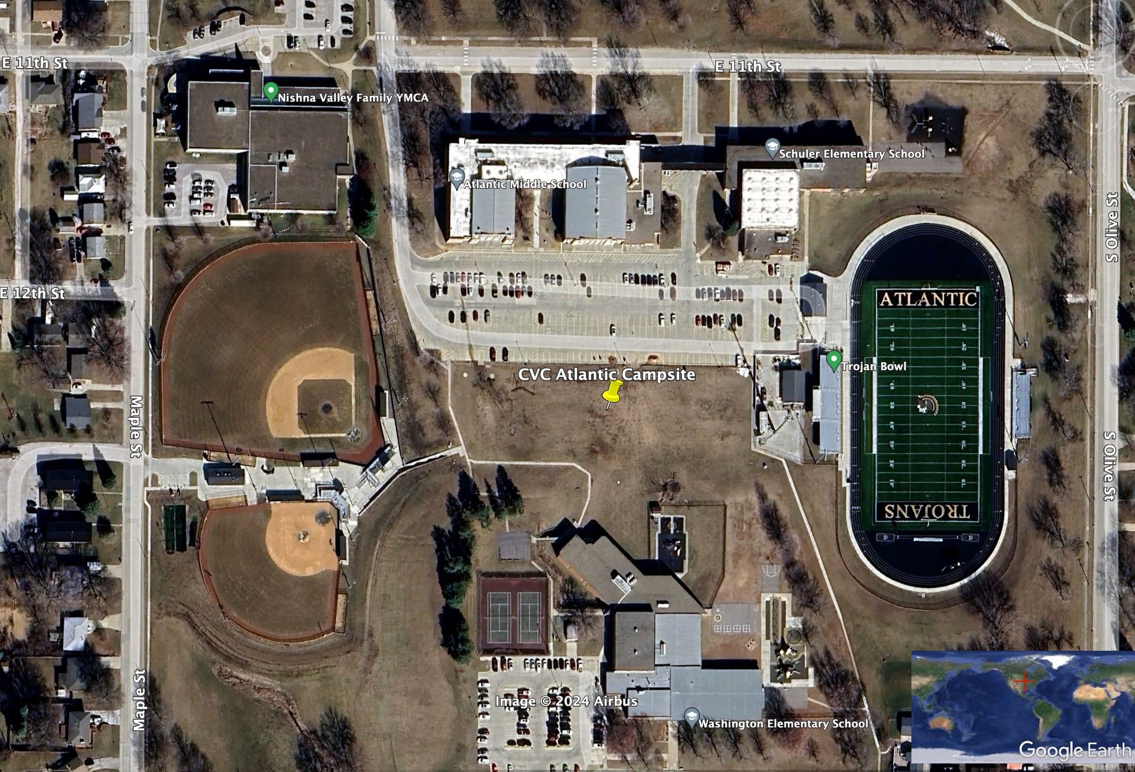
Atlantic: Monday, 22 July 2024
Approximate Street Address:
1100 Lynn St, Atlantic, IA
GPS Coordinates
Lat 41.398435
Lon -95.006273

Slide 11
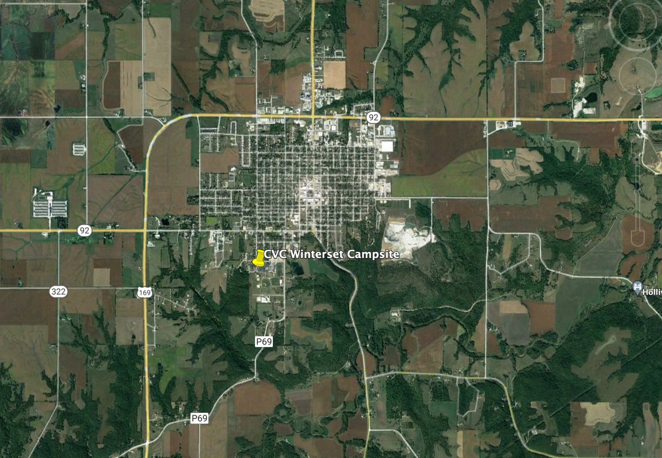
Winterset: Tuesday, 23 July 2024
Approximate Street Address
720 Husky Dr Winterset, IA
GPS Coordinates
Lat 41.325004
Lon -94.023264

Slide 12
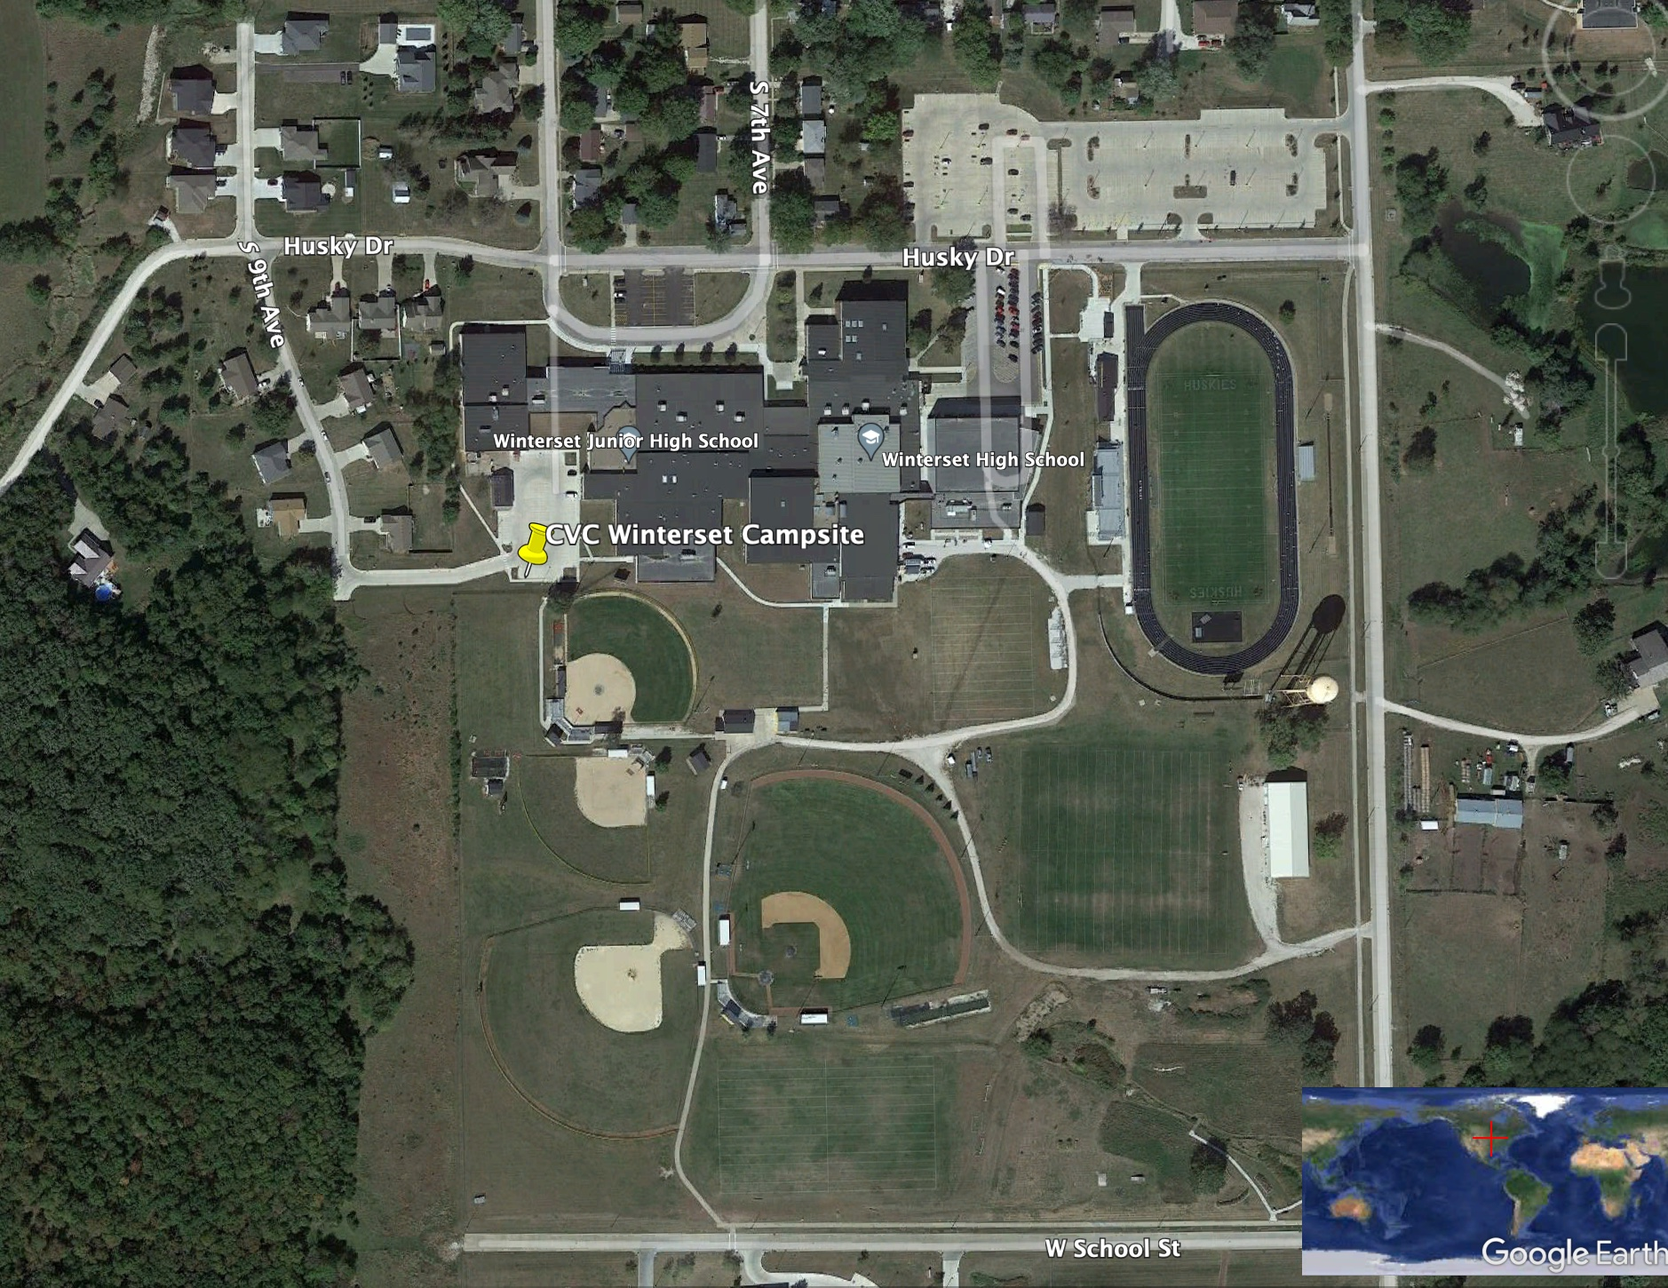
Winterset: Tuesday, 23 July 2024
Approximate Street Address
720 Husky Dr Winterset, IA
GPS Coordinates
Lat 41.325004
Lon -94.023264

Slide 13
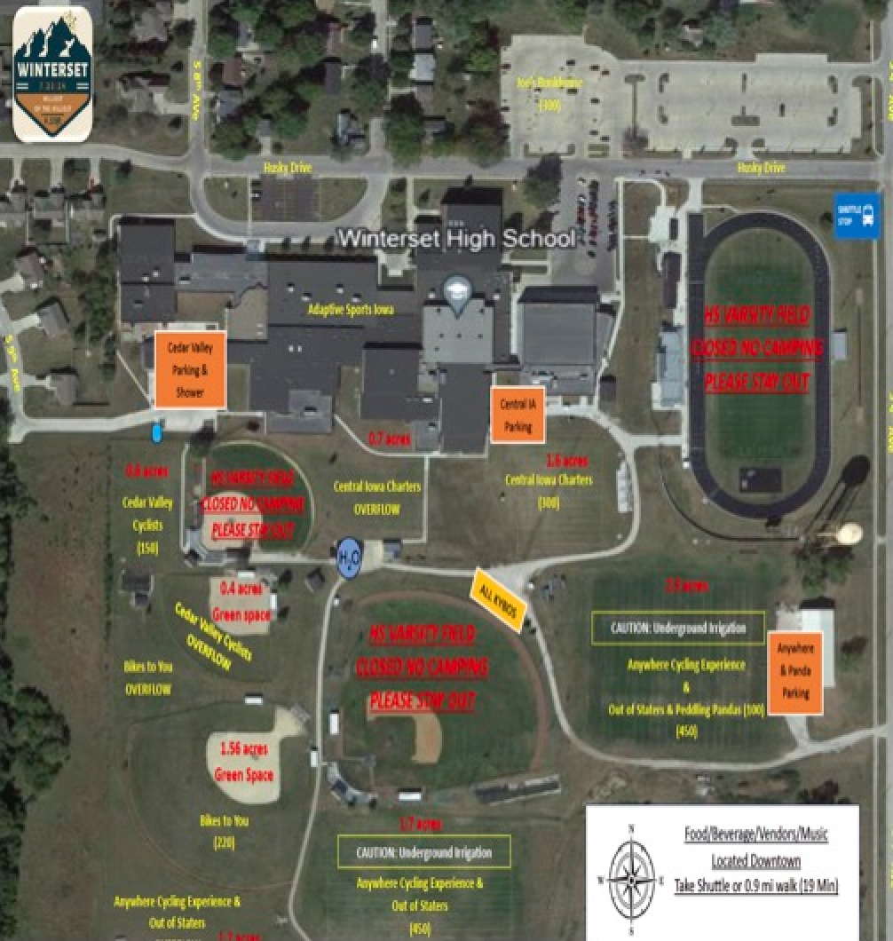
Winterset: Tuesday, 23 July 2024
Approximate Street Address
720 Husky Dr Winterset, IA
GPS Coordinates
Lat 41.325004
Lon -94.023264

Slide 14
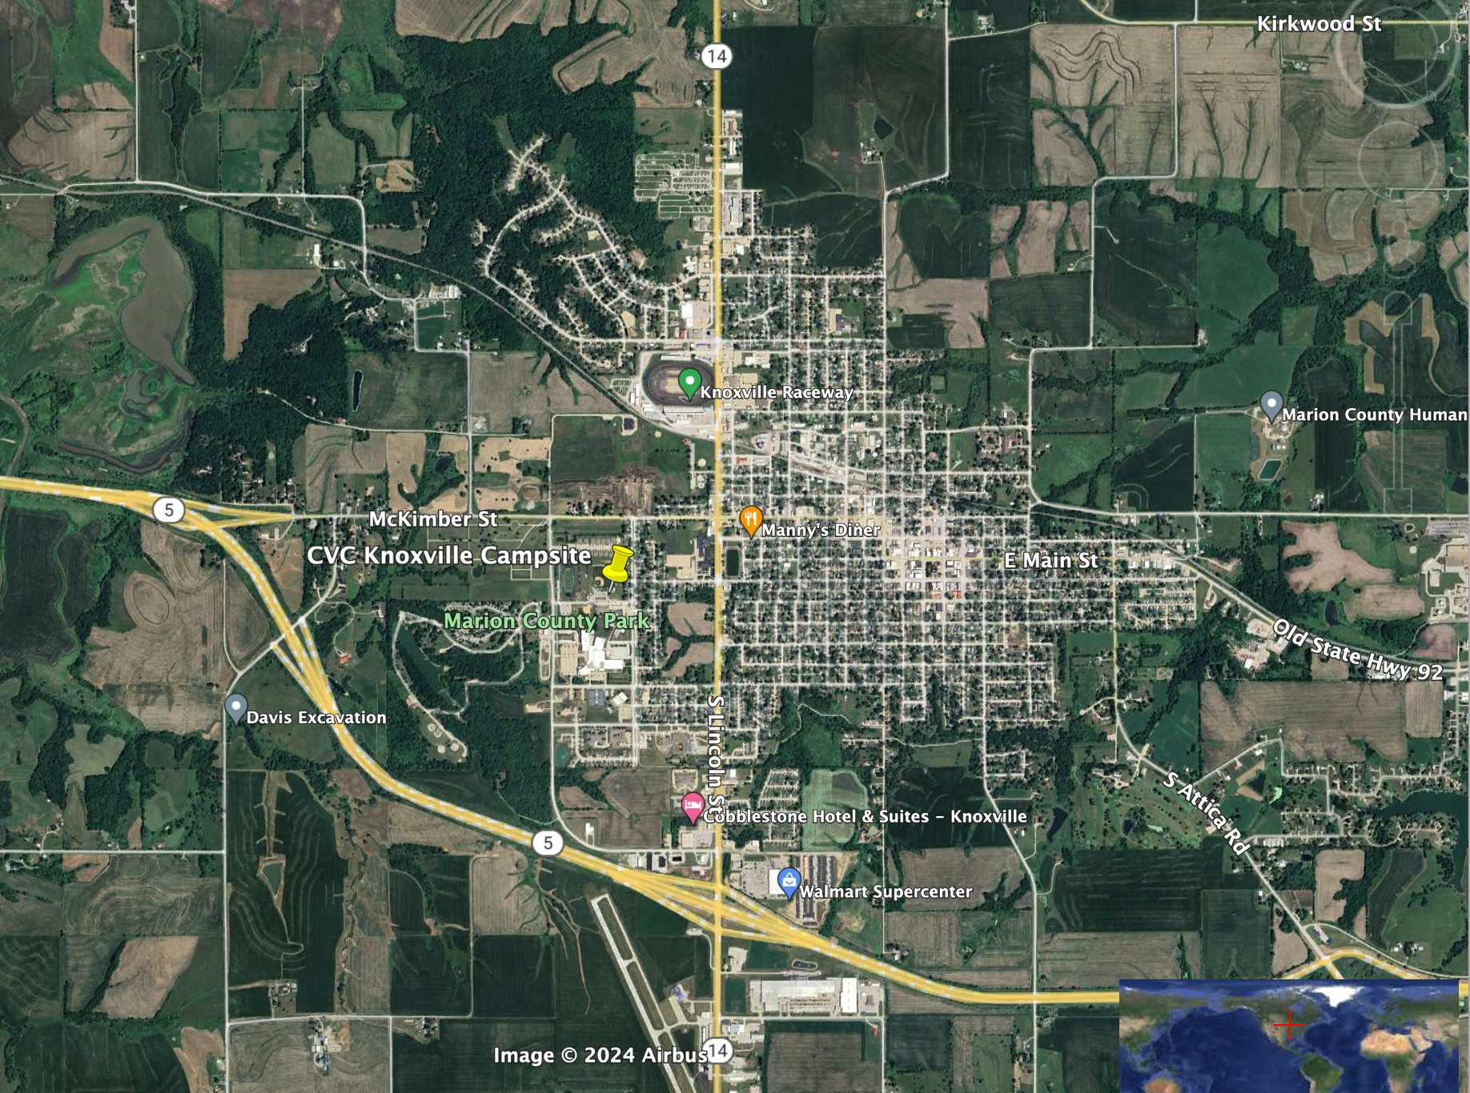
Knoxville: Wednesday 24 July 2024
Approximate Street Address
1811 W Madison St, Knoxville
GPS Coordinates
Lat 41.317444
Lon -93.115811

Slide 15
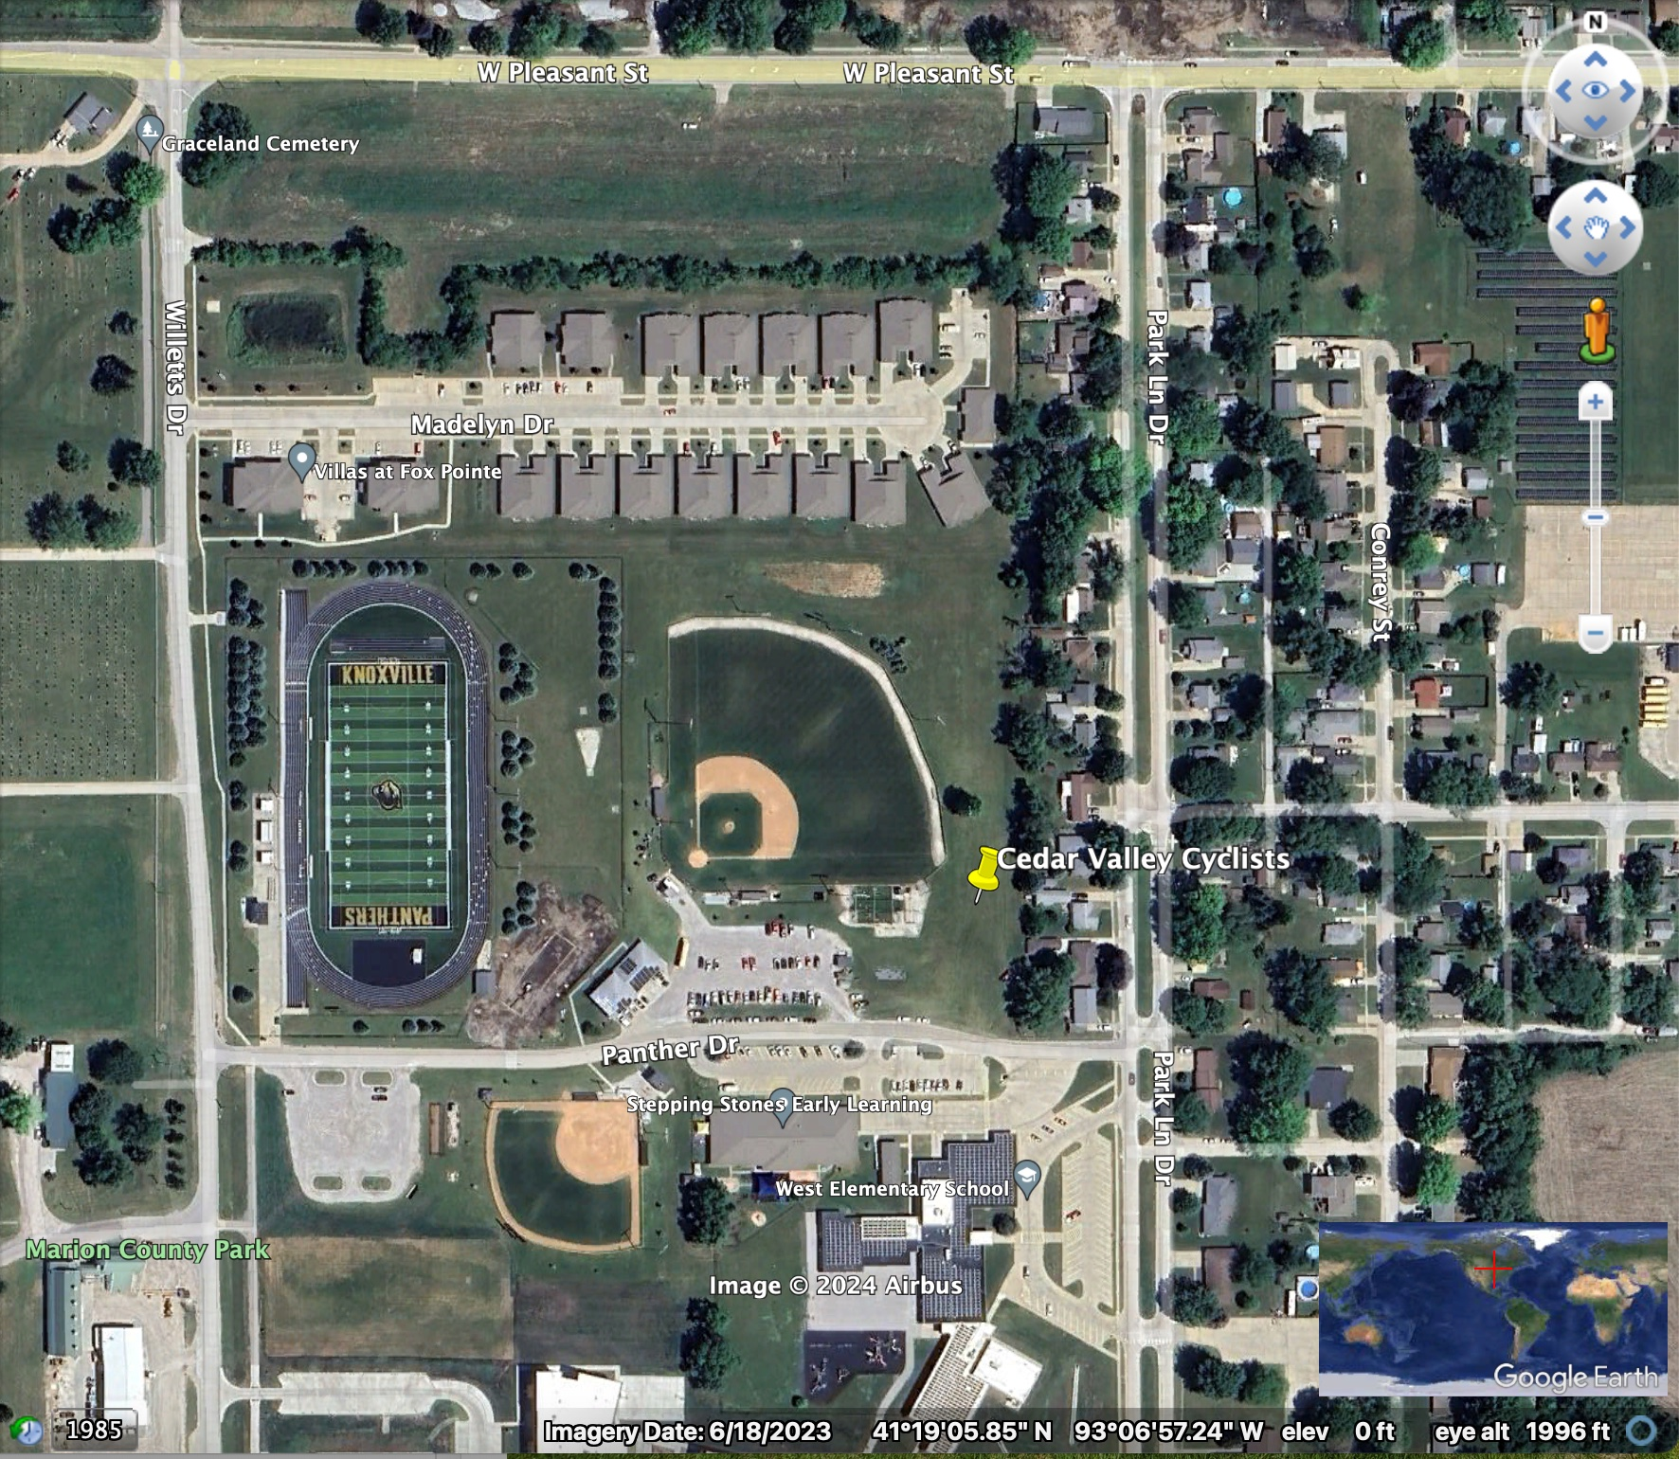
Knoxville: Wednesday 24 July 2024
Approximate Street Address
1811 W Madison St, Knoxville, IA
GPS Coordinates
Lat 41.317444
Lon -93.115811

Slide 16
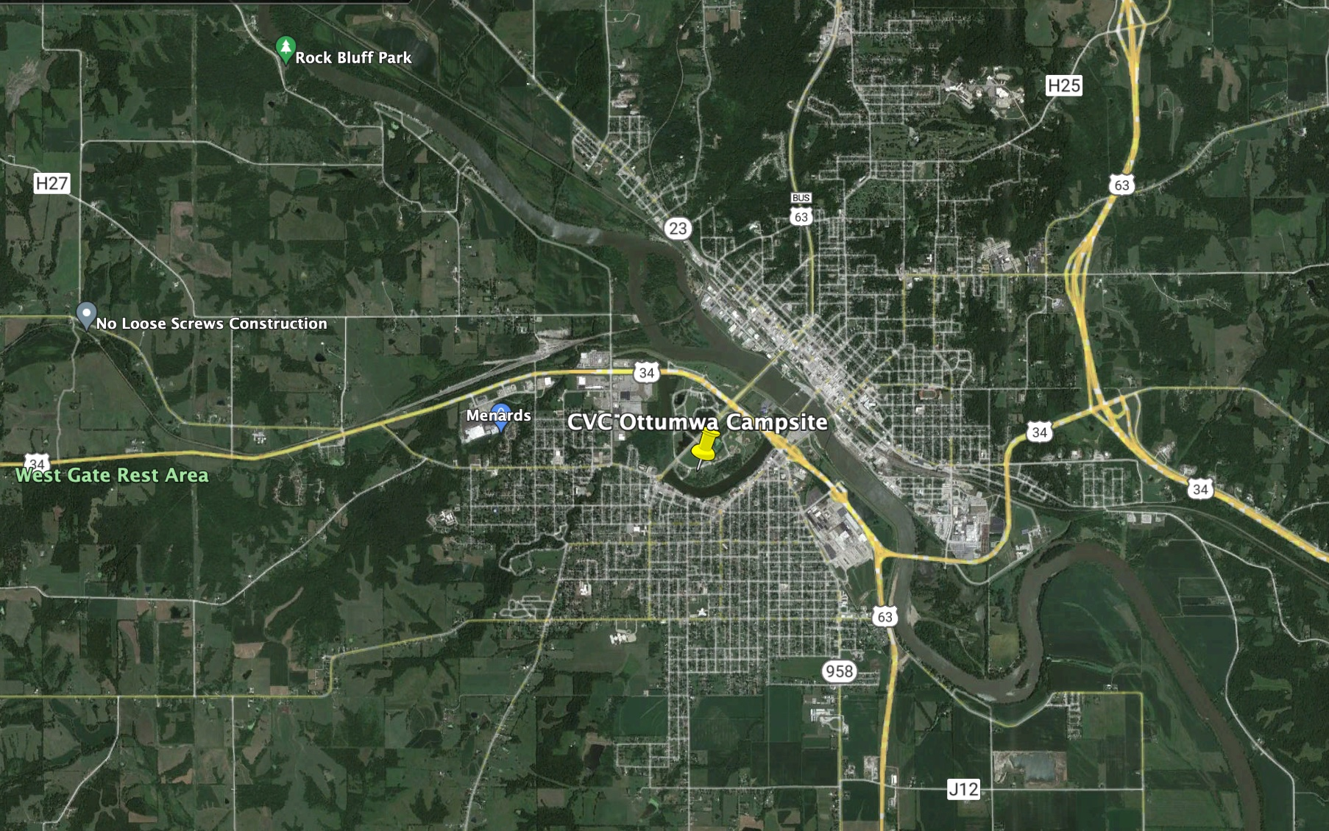
Ottumwa: Thursday, 25 July 2024
Approximate Street Address
Teal Dr, Ottumwa, IA
GPS Coordinates
Lat 41.00884
Lon -92.427599

Slide 17
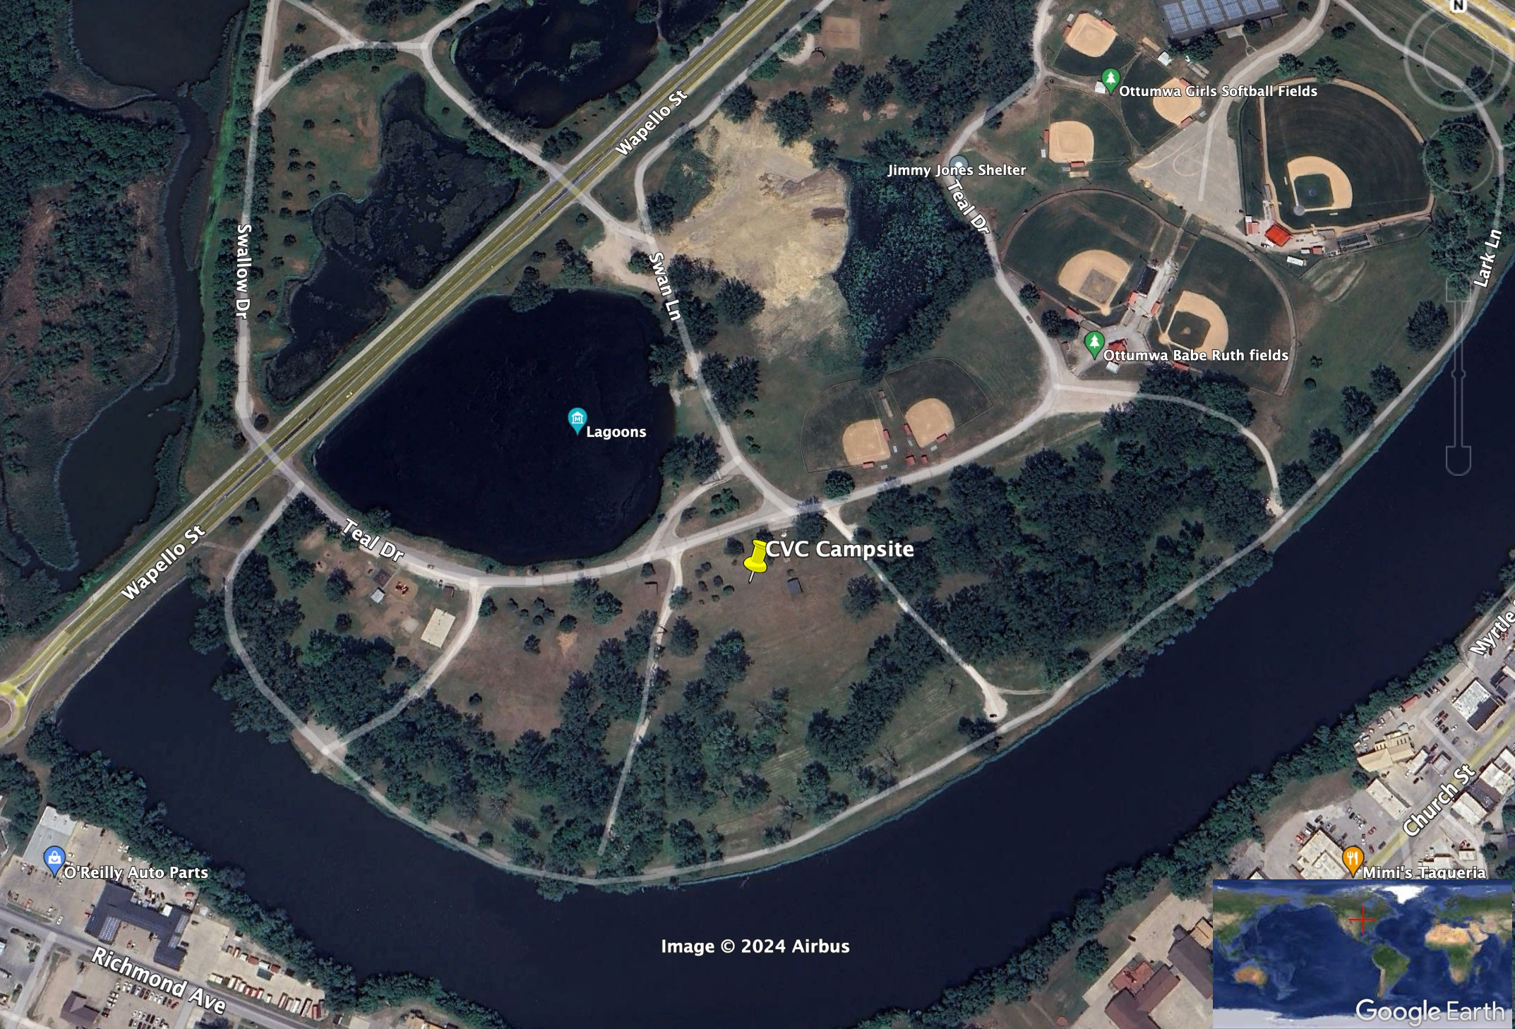
Ottumwa: Thursday, 25 July 2024
Approximate Street Address
Teal Dr, Ottumwa, IA
GPS Coordinates
Lat 41.00884
Lon -92.427599

Slide 18
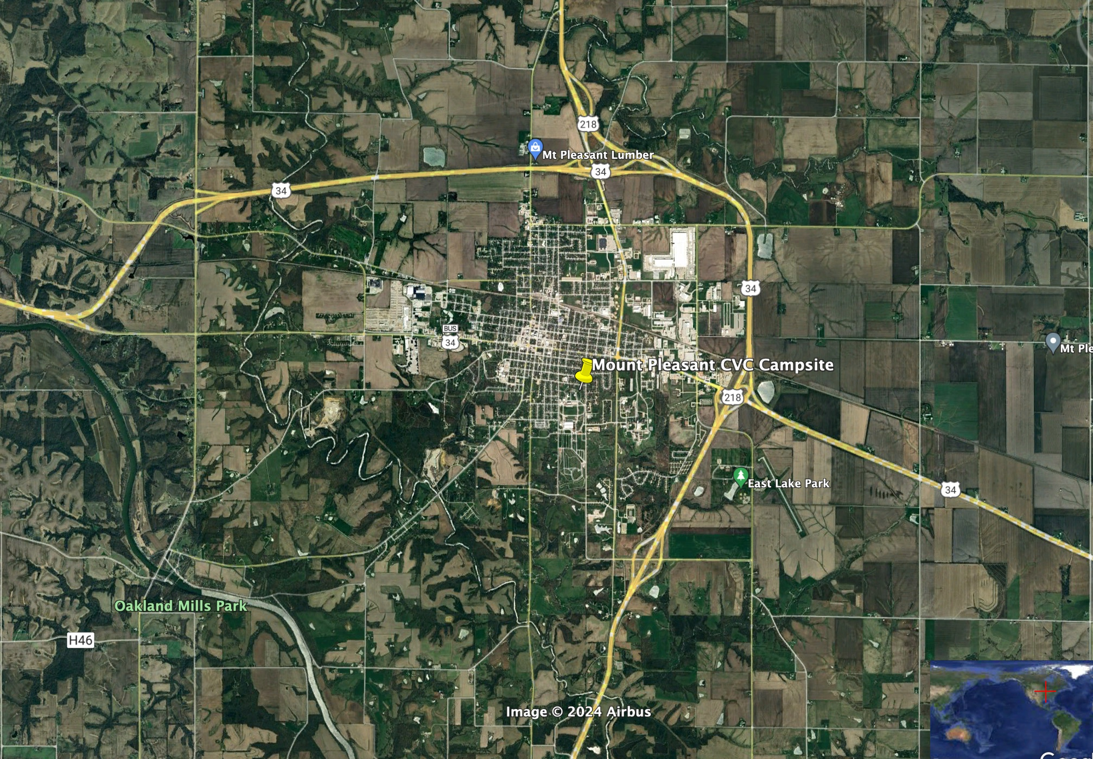
Mount Pleasant: Friday, 26 July 2024
Approximate Street Address
600 E Webster St. Mt Pleasant
GPS Coordinates
Lat 40.959706
Lon -91.545891

Slide 19
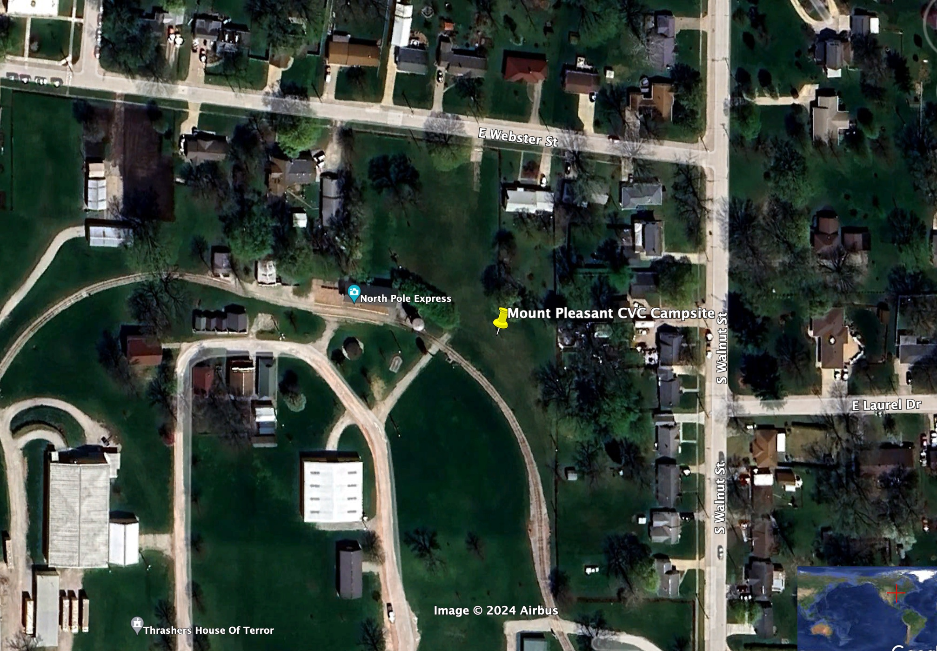
Mount Pleasant: Friday, 26 July 2024
Approximate Street Address
600 E Webster St. Mt Pleasant
GPS Coordinates
Lat 40.959706
Lon -91.545891

Slide 20
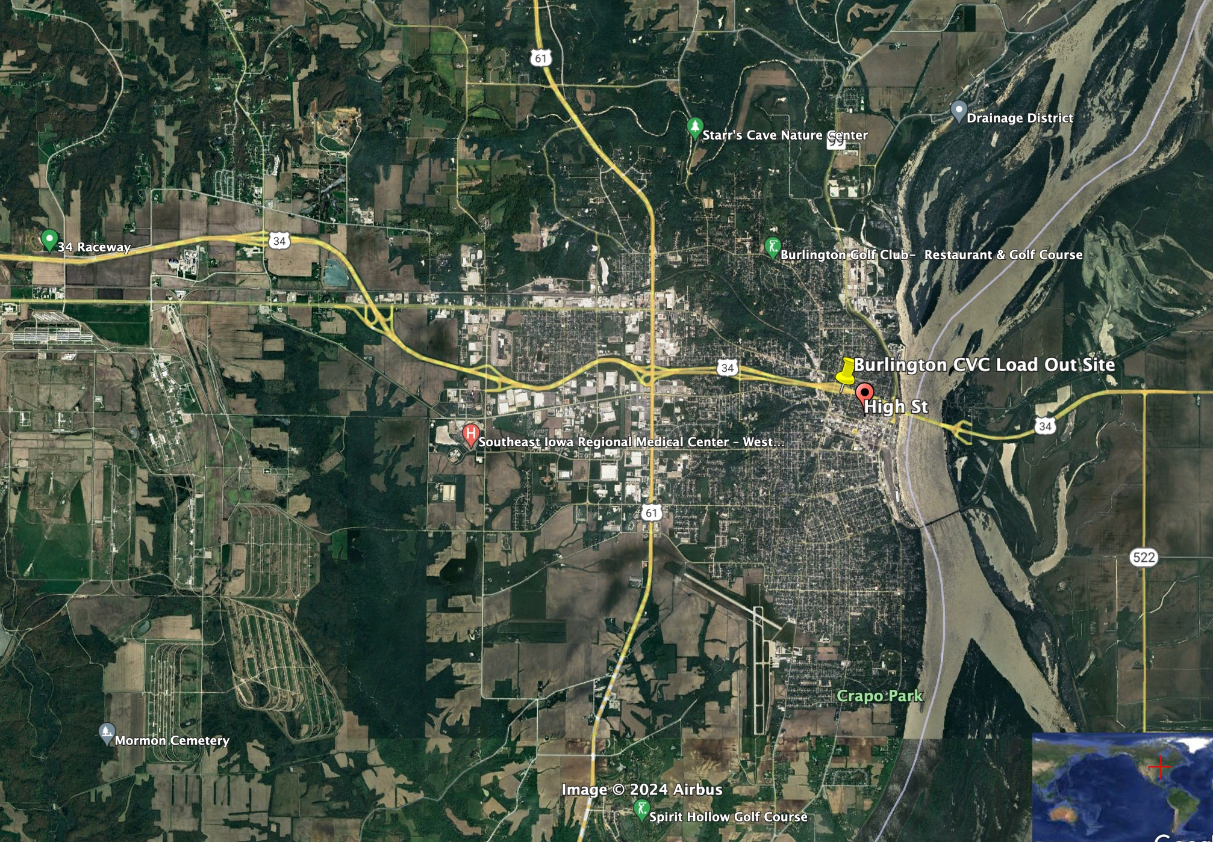
Burlington: Saturday, 27 July 2024
Approximate Street Address
High St Burlington, IA
GPS Coordinates
Lat 40.814984
Lon -91.109077

Slide 21
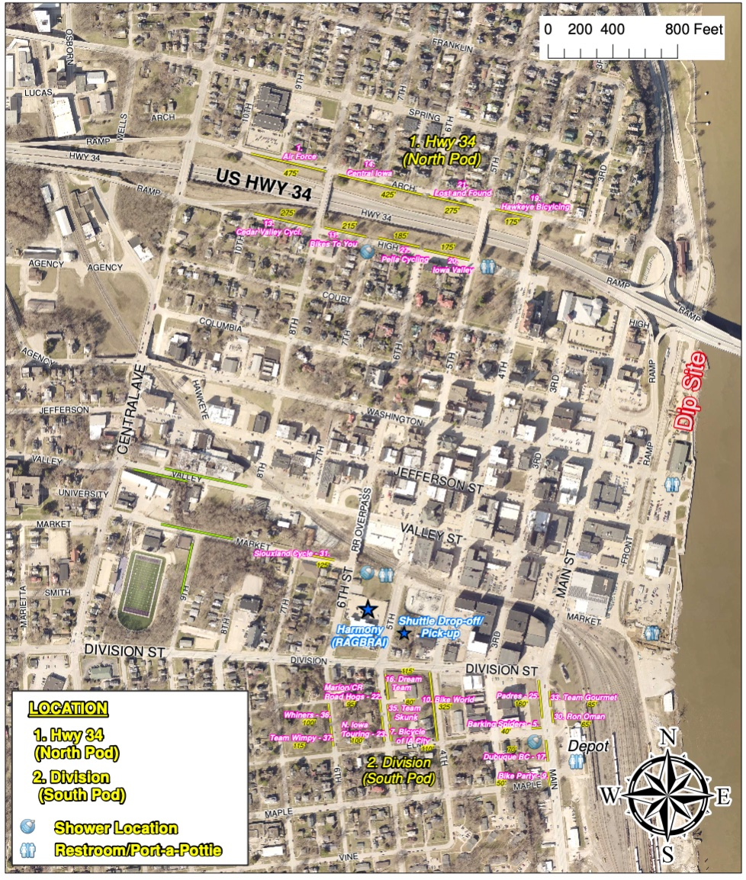
Burlington: Saturday, 27 July 2024
Approximate Street Address
High St Burlington, IA
GPS Coordinates
Lat 40.814984
Lon -91.109077

Slide 22
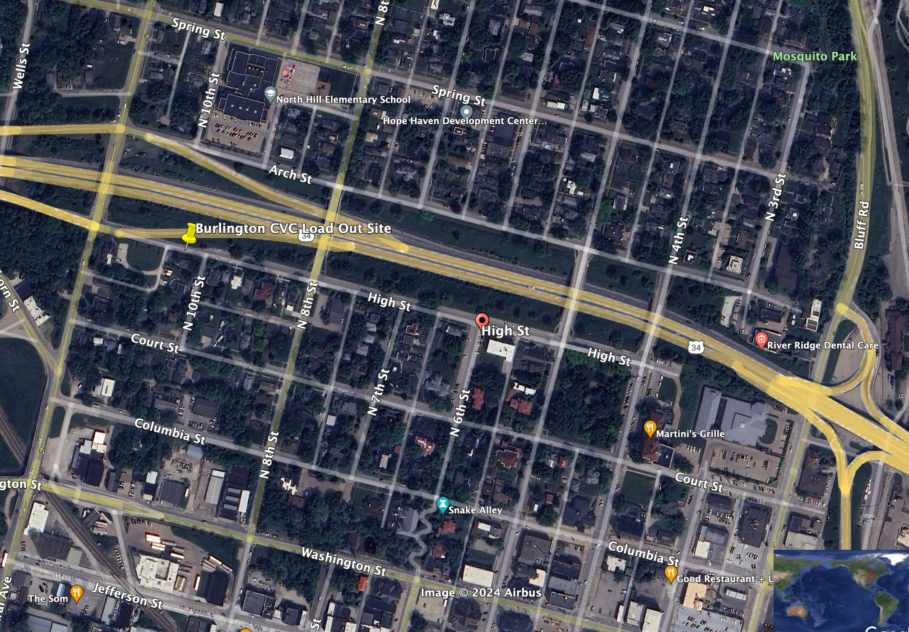
Burlington: Saturday, 27 July 2024
Approximate Street Address
High St Burlington, IA
GPS Coordinates
Lat 40.814984
Lon -91.109077

